Slide 1
Cloud Infrastructure Security
Syed Aquib
Security Fundamentals For Cloud

Slide 2
CC ZG504, Cloud Security Foundations Lecture No.5

Slide 3
Agenda
Part 1: Securing, Hardening, and Patching Virtual Machines (45 minutes)
Introduction to Virtual Machine Security
Hardening Virtual Machines
Patch Management
Image and Configuration Management
Part 2: Security at the Network Layer (45 minutes)
Securing the Network Layer
Virtual Private Cloud (VPC)
Firewalls (FW)
Intrusion Prevention Systems (IPS)
Part 3: Q&A and Wrap-up (30 minutes)
Q&A and Discussion
Conclusion

Slide 4
Session 4: A Quick Recap Federated Identities & Protocols
Federated Identities
Definition: A system enabling users to access multiple services with a single set of credentials, managed by a trusted identity provider (IdP).
Benefits:
Simplified user experience
Reduced administrative overhead
Improved security
Types of Federation
Web-Based: Login to web apps using existing social media or enterprise accounts (e.g., "Sign in with Google").
Enterprise: Access resources across different departments or organizations within an enterprise using company credentials.
Cross-Domain: Extend identity federation across different security domains, enabling secure collaboration between organizations.
Key Protocols & Technologies
SAML: XML-based standard for exchanging authentication and authorization data between an IdP and a service provider.
OAuth: Open standard for authorization, allowing third-party apps access to user resources without sharing credentials.
OpenID Connect: Identity layer on top of OAuth, providing user authentication and information exchange.

Slide 5
Session 4: A Quick Recap
IAM, Entitlement Management, & Audit
IAM Protocols & Specifications
Overview: Define the rules for exchanging identity and access information between systems.
Key Protocols:
SAML, OAuth, OpenID Connect
LDAP, Kerberos, RADIUS
Entitlement Management
Definition: Managing and controlling user access rights to resources based on roles, attributes, etc.
Benefits:
Ensures appropriate access levels.
Reduces risk of unauthorized access.
Simplifies access management.
IAM Audit
Importance: Regular audits ensure IAM policies are effective and compliant.
Key Focus Areas:
User access reviews
Privilege escalation checks
Log analysis
Compliance audits

Slide 6
Introduction to Virtual Machine Security
The Need for VM Security: While VMs offer numerous advantages, they also introduce potential security challenges. VMs can be susceptible to attacks from various sources, including malware, network intrusions, and misconfigurations. Unsecured VMs can lead to data breaches, service disruptions, and financial losses.
Shared Responsibility: Cloud providers implement robust security measures to protect the underlying infrastructure. However, securing VMs is a shared responsibility. Customers play a crucial role in safeguarding their data and applications within the VMs. This includes implementing strong access controls, patching vulnerabilities, and monitoring for suspicious activity.

Slide 7
Hardening Virtual Machines
Definition: Hardening is a proactive security practice that involves reducing the attack surface of a virtual machine. It's akin to locking all the doors and windows of your house, making it significantly more difficult for intruders to gain unauthorized access. We accomplish this by removing any unnecessary software, services, and open ports that could be exploited by attackers.
Key Steps:
Disable Unnecessary Services and Ports
Apply Security Configurations and Updates
Restrict Administrative Access
Implement Strong Password Policies
Use Security Tools

Slide 8
Patch Management
Importance: Patch management is the ongoing process of applying software updates and security patches to address vulnerabilities and fix bugs in your virtual machines. It's like regularly servicing your car to keep it running smoothly and prevent breakdowns. Failing to patch can leave your VMs exposed to known exploits, making them an easy target for attackers.
Challenges:
Dynamic Cloud Environments: Cloud environments are constantly evolving, with new VMs being spun up and existing ones being modified or terminated. This dynamic nature can make it challenging to track and patch all VMs effectively.
Minimizing Downtime: Patching often requires rebooting VMs, which can lead to service disruptions. It's crucial to minimize downtime to ensure business continuity.
Ensuring Compatibility: Patches can sometimes introduce compatibility issues with existing applications or configurations. Thorough testing is necessary to avoid unintended consequences.
Best Practices:
Establish a Patch Management Process: Define clear procedures for identifying, prioritizing, testing, and deploying patches.
Prioritize Critical Patches: Focus on patching vulnerabilities that pose the highest risk to your organization.
Test Patches in a Non-Production Environment: Before applying patches to production VMs, test them in a controlled environment to identify any potential issues.
Automate Patch Deployment: Use automation tools to streamline the patching process and reduce the risk of human error.

Slide 9
Image and Configuration Management
Golden Images: A golden image is a pre-configured, secure, and standardized template for creating new virtual machines. It acts as a blueprint, ensuring all VMs deployed from this image start with a known and hardened configuration. This reduces the risk of misconfigurations and vulnerabilities that can arise from manual setups.
Configuration Management Tools: These tools automate the process of configuring and maintaining VMs, ensuring consistency across multiple instances. They allow you to define desired configurations (e.g., software installations, security settings) and automatically apply them to VMs, even as they scale up or down. This eliminates manual configuration errors and saves significant time and effort.

Slide 10
Securing the Network Layer
Why Network Security is Critical for Cloud Security
Data Protection: Networks act as conduits for sensitive information. Network security measures like encryption and access controls ensure that data remains protected both in transit and at rest, preventing unauthorized access and data breaches.
System Availability: Network security safeguards against attacks like Distributed Denial of Service (DDoS) that aim to disrupt services and render systems unavailable. This ensures uninterrupted access to critical cloud resources.
Threat Mitigation: By implementing firewalls, intrusion detection systems, and other network security mechanisms, organizations can proactively identify and mitigate threats, preventing them from impacting the cloud environment.
Regulatory Compliance: Many industries have stringent data protection regulations. A strong network security posture helps organizations comply with these regulations and avoid penalties.

Slide 11
Securing the Network Layer
Common Network-Based Threats
Unauthorized Access: This involves gaining access to network resources without proper authorization. This can be achieved through techniques like password cracking, exploiting vulnerabilities, or social engineering.
Data Interception: Attackers may attempt to intercept data in transit to steal sensitive information like login credentials, financial data, or personal information.
DDoS Attacks: These attacks overwhelm network resources with a flood of traffic, rendering services unavailable to legitimate users.
Malware: Malicious software can infiltrate networks through various means, like phishing emails or drive-by downloads. Once inside, malware can steal data, disrupt operations, or create backdoors for further attacks.

Slide 12
Securing the Network Layer
Key Network Security Measures
Firewalls: Act as a barrier between trusted and untrusted networks, controlling incoming and outgoing traffic based on predefined rules.
Intrusion Detection and Prevention Systems (IDS/IPS): Monitor network traffic for suspicious activity and can take automated actions to block threats.
Virtual Private Networks (VPNs): Create secure, encrypted tunnels for data transmission over public networks.
Network Segmentation: Divides the network into smaller segments to isolate sensitive data and limit the impact of breaches.
Regular Security Assessments: Conduct vulnerability scans and penetration tests to identify and address weaknesses before they are exploited.

Slide 13
Virtual Private Cloud (VPC)
1. Network Isolation and Segmentation
A VPC acts as a virtual fence, segregating your cloud resources from those of other cloud users. This isolation ensures that your applications and data remain secure and protected from unauthorized access. You can further enhance isolation by segmenting your VPC into multiple subnets, each serving specific purposes or hosting different types of workloads.
2. Control Over IP Address Ranges, Subnets, and Routing Tables
Within your VPC, you have full autonomy to define the IP address ranges, create subnets, and configure routing tables. This granular control allows you to design a network topology that perfectly suits your application architecture and facilitates efficient communication between your resources.
3. Enhanced Security and Privacy
VPCs offer robust security features to safeguard your cloud environment. You can implement security groups (virtual firewalls) to control inbound and outbound traffic, define network access control lists (ACLs) to filter traffic at the subnet level, and leverage VPN connections for secure access to your VPC resources from on-premises networks. These security measures help protect your data and applications from unauthorized access and potential threats.

Slide 14
Firewalls (FW)
Purpose: A firewall is a network security system that acts as a barrier between a trusted internal network and an untrusted external network (such as the internet). Its primary function is to monitor and control incoming and outgoing network traffic based on a set of predefined security rules. These rules dictate which types of traffic are permitted or blocked, helping to prevent unauthorized access and malicious activities.
Types of Firewalls:
Network Firewalls: These firewalls operate at the network layer, inspecting packets based on their source and destination IP addresses, ports, and protocols. They can filter traffic based on specific criteria, such as allowing or blocking certain types of traffic (e.g., HTTP, FTP, SSH) or restricting access to specific IP addresses or port ranges.
Web Application Firewalls (WAFs): WAFs are specialized firewalls designed to protect web applications from attacks that exploit vulnerabilities in application code or protocols. They analyze HTTP/HTTPS traffic and can detect and block malicious requests, such as SQL injection attacks, cross-site scripting (XSS), and cross-site request forgery (CSRF). WAFs provide an additional layer of security beyond traditional network firewalls.

Slide 15
Real-World Examples of Firewalls (FW)
Home Router Firewall: Most home routers come equipped with a built-in firewall that protects your home network from unauthorized access and malicious traffic from the internet. It typically blocks incoming connections from the internet unless specifically configured to allow them.
Corporate Network Firewall: Large organizations often use sophisticated firewalls at the edge of their network to protect against external threats. These firewalls filter traffic based on complex rules, ensuring that only authorized access is granted to internal resources.
Cloud Firewall: Cloud providers offer virtual firewalls to protect cloud-based resources and applications. These firewalls can be configured to control traffic between different cloud instances or between the cloud and the internet.
Web Application Firewall (WAF): A WAF protects web applications by filtering, monitoring, and blocking HTTP/HTTPS traffic. It can detect and prevent attacks such as SQL injection and cross-site scripting (XSS). A popular WAF example is Cloudflare's WAF service, used by many websites to protect against malicious web requests.

Slide 16
Intrusion Prevention Systems (IPS)
Purpose:
Intrusion Prevention Systems (IPS) serve as proactive network security solutions, designed to not only detect but also prevent malicious network activity in real time. While traditional firewalls act as a barrier, allowing or blocking traffic based on predefined rules, IPS goes a step further by actively analyzing network traffic and taking immediate action to thwart threats as they occur.
How IPS Works:
IPS employs a multi-pronged approach to identify and neutralize threats:
Signature-Based Detection: IPS maintains a database of known attack signatures, representing patterns or characteristics associated with specific exploits or malware. By continuously scanning network traffic against this database, IPS can identify and block malicious packets before they reach their intended targets.
Anomaly-Based Detection: IPS also utilizes anomaly-based detection techniques to identify unusual or suspicious behavior that deviates from established network baselines. This helps to detect new or unknown attacks that may not have a corresponding signature.
Real-Time Prevention: When IPS detects a potential threat, it takes immediate action to prevent the attack from succeeding. This may involve dropping malicious packets, blocking the source IP address, or resetting the connection.

Slide 17
Intrusion Prevention Systems (IPS)
Key Benefits of IPS:
Proactive Threat Detection and Prevention: IPS acts as a first line of defense, actively blocking threats before they can cause damage. This proactive approach significantly reduces the risk of successful attacks and data breaches.
Enhanced Security Posture: By adding an additional layer of security beyond traditional firewalls, IPS strengthens your overall security posture. It provides comprehensive protection against a wide range of network threats, including known and unknown attacks.
Real-Time Visibility: IPS provides real-time visibility into network traffic and security events, allowing you to identify and respond to threats quickly. Detailed logs and alerts enable you to track attack patterns and trends, helping you stay ahead of emerging threats.
Regulatory Compliance: IPS can assist in meeting regulatory compliance requirements by demonstrating proactive measures to protect sensitive data and prevent security incidents.

Slide 18
Real-World Examples of Intrusion Prevention Systems (IPS)
Snort: Snort is a widely used open-source IPS that can detect and block various types of network attacks. It uses a combination of signature-based and anomaly-based detection techniques to identify threats.
Suricata: Another popular open-source IPS, Suricata, provides similar capabilities to Snort and is often used in high-performance network environments.
Cisco Firepower: Cisco's Firepower product line includes both firewalls and IPS capabilities. It offers advanced threat detection and prevention using a combination of signature-based, anomaly-based, and reputation-based analysis.
Next-Generation Firewall (NGFW): Many NGFWs incorporate IPS functionality alongside traditional firewall capabilities. This allows for a more integrated and efficient approach to network security. Palo Alto Networks and Fortinet are examples of vendors offering NGFW solutions with built-in IPS.
Endpoint Protection Platform (EPP): Some EPPs include host-based IPS components to protect individual endpoints from malicious network traffic. These solutions complement network-based IPS by providing an additional layer of security at the device level.

Slide 19

Trends and Future Directions

Slide 20
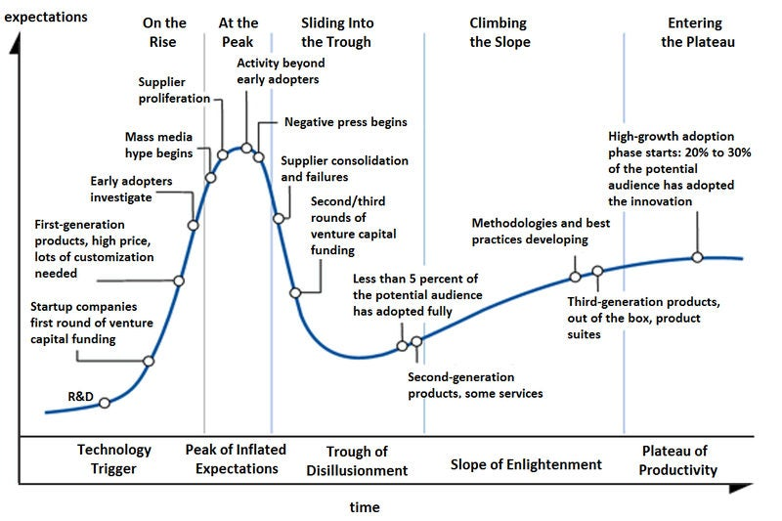
Gartner Hype Cycle

Slide 21
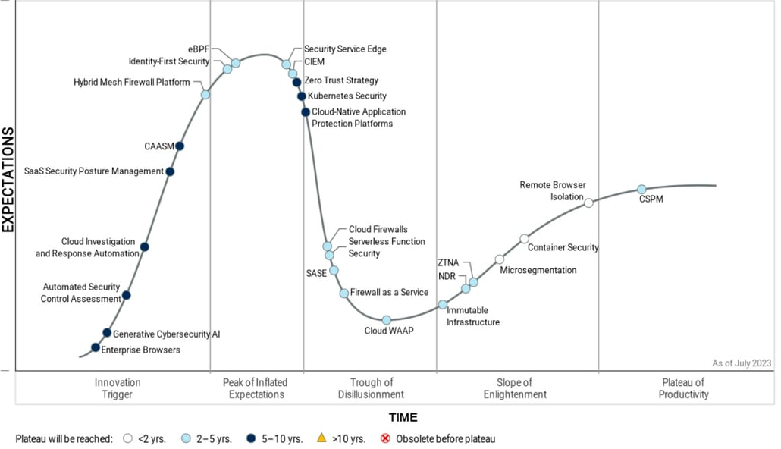
Hype Cycle for
Workload and Network Security

Slide 22
Trends and Future Directions
1. The Rise of CNAPP
Cloud-Native Application Protection Platforms (CNAPP) are gaining significant traction, moving closer to mainstream adoption.
CNAPP integrates various security capabilities, including Cloud Security Posture Management (CSPM), Cloud Workload Protection Platforms (CWPP), and Kubernetes Security Posture Management (KSPM).
This consolidation simplifies security for cloud-native environments.
2. The Maturing of ZTNA
Zero Trust Network Access (ZTNA) is moving towards the "Slope of Enlightenment" phase, indicating growing understanding and acceptance.
ZTNA is vital for secure remote access and aligns with the broader shift towards Zero Trust security principles.

Slide 23
Trends and Future Directions
3. The Growing Importance of API Security
API Security is recognized as crucial, with a focus on protecting APIs throughout their lifecycle.
Increased API adoption and associated risks drive this emphasis.
4. The Continued Relevance of SASE
Secure Access Service Edge (SASE) remains a prominent technology, converging network and security functions.
SASE simplifies security for distributed workforces and cloud-based resources.
5. The Emergence of XDR
Extended Detection and Response (XDR) is gaining visibility, offering unified threat detection and response across various security tools.
XDR improves threat visibility and incident response capabilities.

